Slide 1


DEPARTMENT OF MECHANICAL ENGINEERING
SECOND REVIEW
RESEARCH OF RECHARGABLE ELECTRIC VEHICLE
TEAM MEMBERS: GUIDED BY:
Kiruthika S (927622BME041) Dr.S.Padmavathy
Krithik S (927622BME043) Associate professor/Mech
Lalithraj R (927622BME044)

Slide 2
PRESENTATION OUTLINE
Problem Statement
Objective
Working
Materials Required
Conclusion

Slide 3
PROBLEM STATEMENT
Limited driving range of Electric vehicle
High battery replacement costs
Dependence on charging infrastructure
Environmental impact of battery disposable

Slide 4
OBJECTIVES
Increase driving range and efficiency
Design a rechargeable Electric vehicle system
Reduce battery replacement costs
Minimize environmental impact

Slide 5
WORKING
This system has the dc generator which is connected to the wheel system It is enabled when there is need to charge the battery This system is connected to the battery so the battery is charged while it's running.
So the speed or performance of the electric vehicle is slowed when it's charging but when it's charged we can able to disenable it

Slide 6
MATERIALS REQUIRED
Motor
Generator
Rechargeable Battery
Temperature Sensors

Slide 7
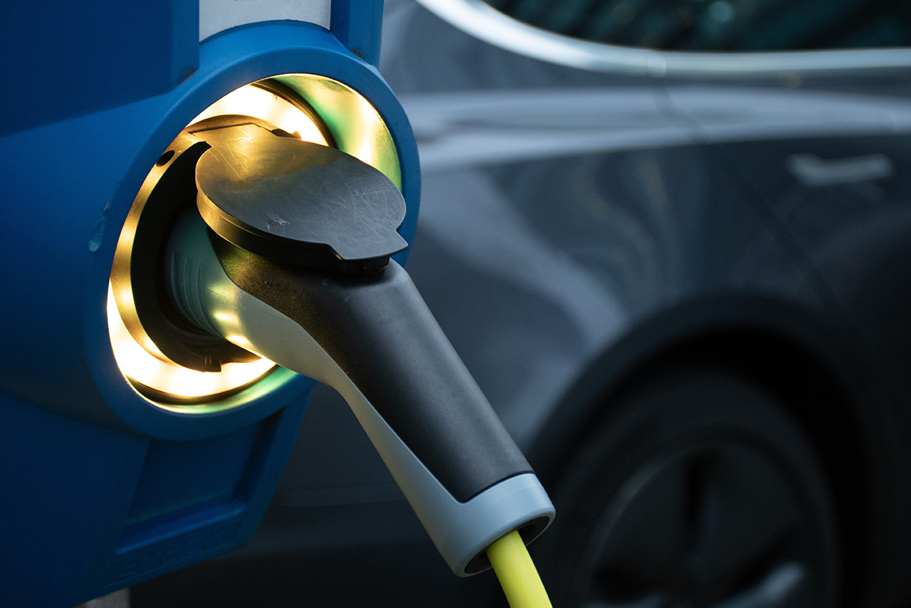
CONCLUSION
By Using this project we can efficiently recharge the battery while it’s travelling.

Slide 8
THANK YOU

